Slide 1

Conditional Logic & Sensors: Making Our Programs Smart!
Today, we'll learn how computers can make choices, and how we can teach them to react to things around them using sensors.

Slide 2
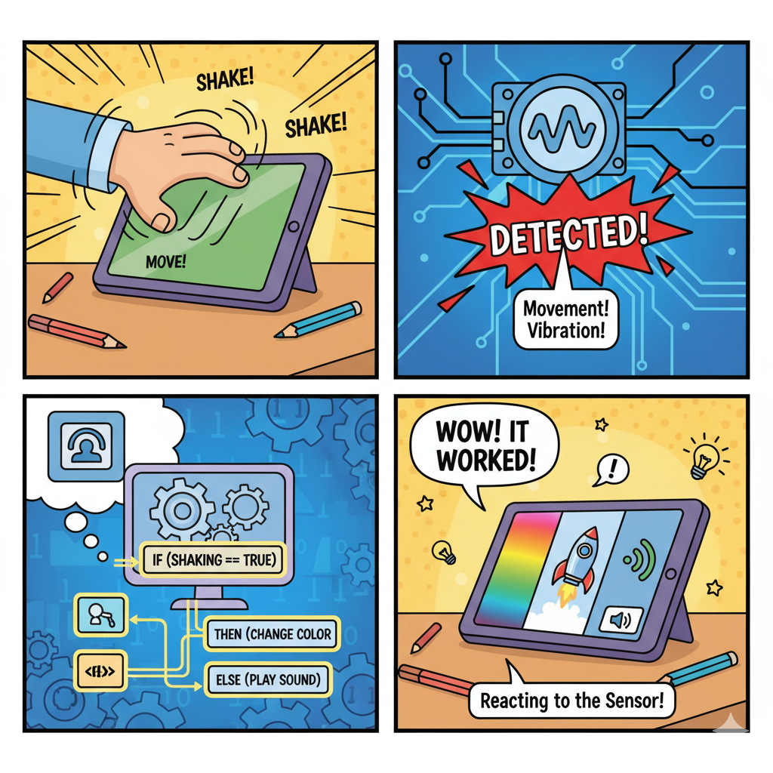
Lesson Overview
Today you will learn to:
Understand IF/ELSE logic - Make your program make decisions
Use the Accelerometer sensor - Detect shaking and movement
Program Smart Responses - Make your astronaut react to motion!
Notes:
Learn how programs make choices based on rules, just like we do every day
Discover how to detect movement and shaking with a special sensor.
Create programs that react differently depending on what the sensor "feels."

Slide 3
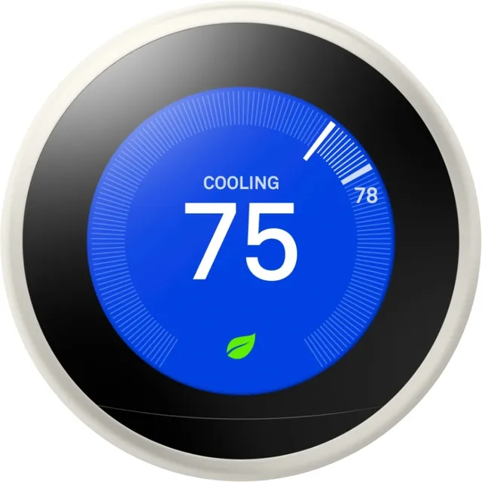
What is Conditional Logic?
Conditional logic = Making decisions based on conditions
Imagine telling a computer: "IF it's raining, THEN take an umbrella, ELSE leave it at home."
That's conditional logic! It's all about making decisions.
Another example - Smart thermostat:
IF the room is too hot, THEN turn on the air conditioner
ELSE (if it's not too hot), keep it off

Slide 4
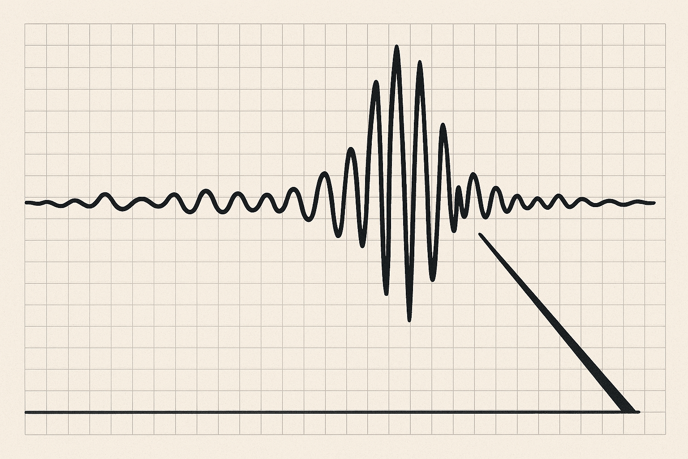
Meet Your New Sensor: The Accelerometer!
What is it? An accelerometer detects movement and shaking - like the sensor in your phone that knows when you tilt it!
How it Works:
No movement = low numbers (like 0-5)
Gentle movement = medium numbers (like 10-20)
Energetic shaking = high numbers (like 50+)
The Magic of Thresholds: A threshold is a "trigger number" that makes something happen.
Notes:
An accelerometer is like a tiny sensor that can tell when something is moving, tilting, or shaking - just like how you can feel when you're in a car that's speeding up or going around a corner!

Slide 5

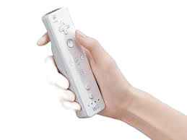
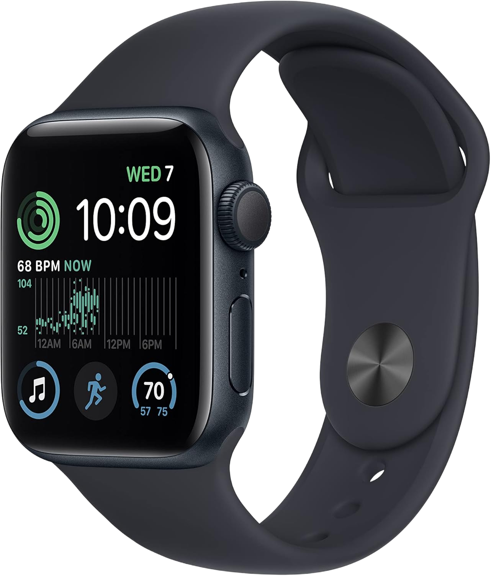
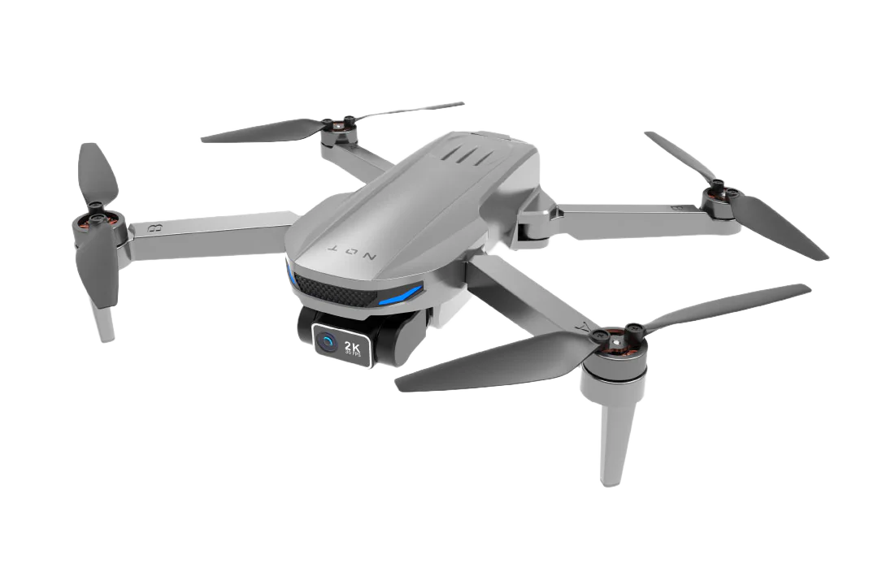
Nintendo Switch - motion controls in games like Mario Kart (steering)
Wii Remote - motion sensing for sports games and dancing
Smart watches - tracks when you're walking, running, or exercising
Drones - keeps them stable and level while flying

Slide 6
Core Activity
🔴 Shake for Red!
What happens:
IF Sphero shakes hard
THEN set Main LED to RED
AND play Alarm Sound
The code block: if (is_shaking?(red))
🟢 Still for Green!
What happens:
ELSE (if not shaking)
THEN set Main device to still, GREEN
AND play Gentle Sound
The code block: set_main led(green)
🔄 Loop & Test!
Keep it running:
Repeat forever
Run your program! Does it work?
Share & refine!
Why loop forever? Your program needs to keep checking: "Am I shaking? Am I still?" over and over again - that's how it knows when to change!
Notes:
Model to students -

Slide 7
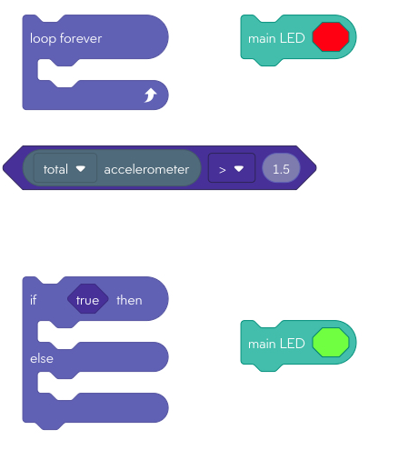

Step 1: Test the accelerometer
Shake your device gently, then harder
Watch how the accelerometer numbers change on screen
Find the threshold that works best for your astronaut
Step 2: Set your threshold
What happens: When shaking goes above your threshold number, your astronaut will jump!
Try these numbers:
1.5 = very sensitive (tiny shake = jump)
2.5 = medium (normal shake = jump)
3.0 = less sensitive (hard shake = jump)
Keep testing until it feels just right!
Tip: Try light shakes vs. hard shakes to see the difference!

Slide 8
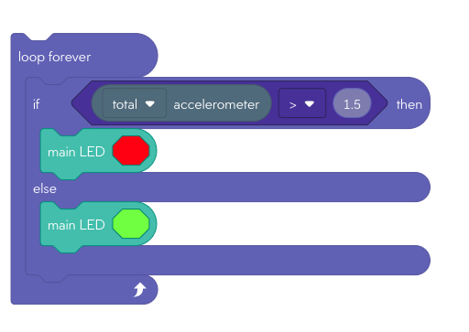
Core solution

Slide 9
Success Check! ✓
Can you explain these?
✓ I can explain what the accelerometer sensor measures
✓ I can explain what the "threshold" number does
✓ I understand how IF/ELSE helps programs make decisions
✓ I can explain why "loop forever" is important in our program

Slide 10
How could we use this technology to help solve a real life problem?
When would we need to detect different levels of the Earth’s movement?

Slide 11
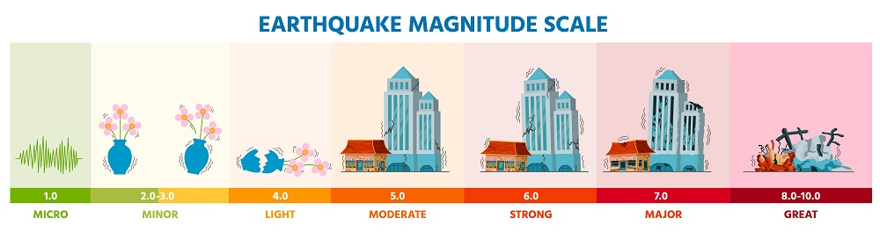
Can you build an earthquake alert system using:
multiple IF/ELSE statements
sound - giving warnings
lights
different thresholds
How could you simulate an earthquake to test it?

Slide 12



Beyond the Basics: Challenge Cards!
`
Motion detector Multiple levels
Lightning Detector
Using Ambient light sensor
Create 3 Levels
Use multiple IF statements for different thresholds
Ambient Light Sensor will be the inverse (<)
Green Card: Add sounds to your current program
Create 3 levels: Green (still), Yellow (moderate), Red (fast).
Add different sounds: alarm for motion, gentle for stillness.
Use multiple IF statements for different thresholds.
Experiment with different movement levels.
Hot
Spicy
Notes:
Can extend students to add, scrolling text blocks to their programs, add sounds or speak blocks, spin/raw motor blocks, matrix animations etc Ambient Light Sensor - Will have a value of around 100 lux when put under the light - Try starting with if ambient light <1200
Hot could be a earthquake alert system?

Slide 13
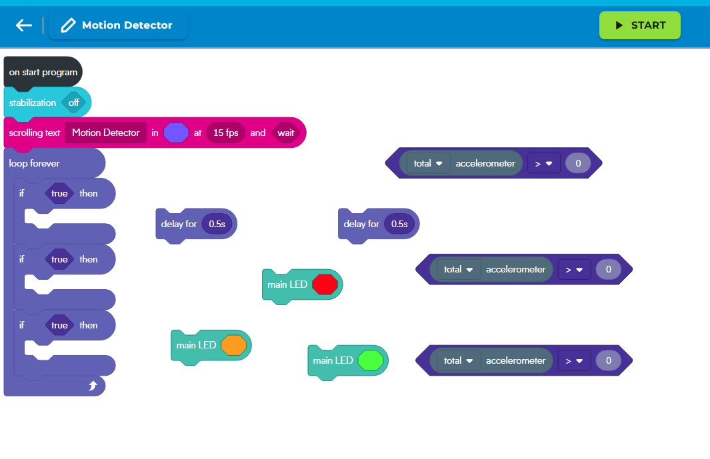
Hot
Notes:
A copy of this project is here https://drive.google.com/drive/folders/1KoTSDbW6Hkyzrx8eUJFGTaDPjWMUI6TT?usp=drive_link

Slide 14
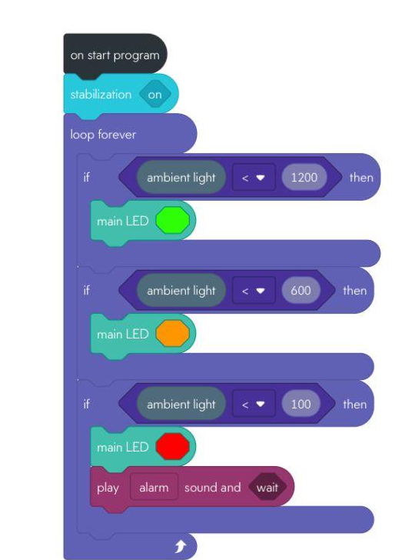
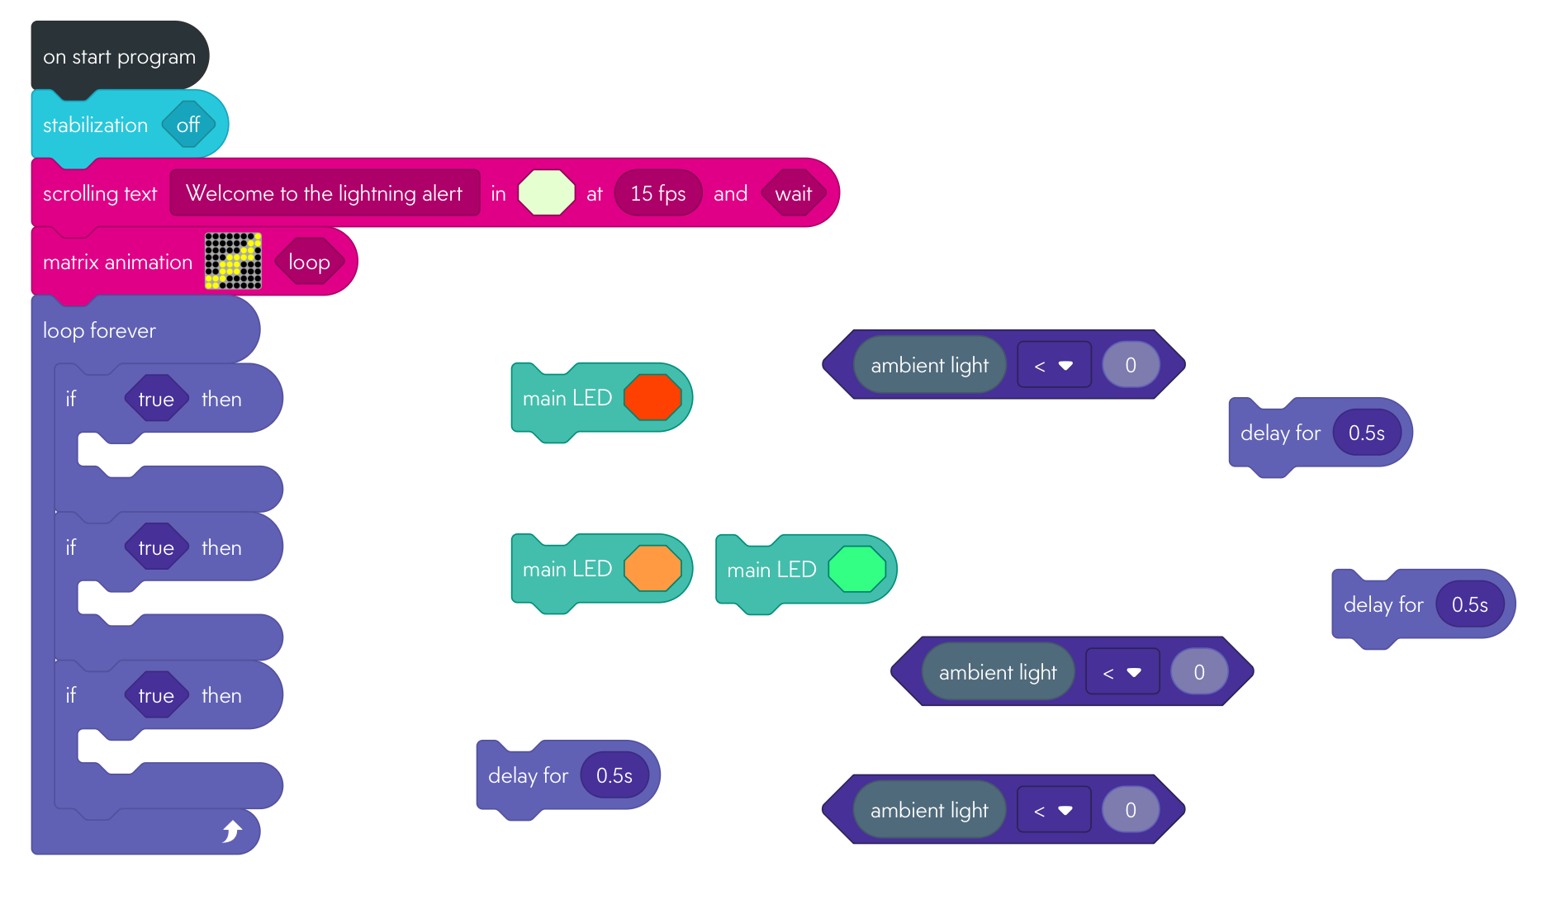
Lightning Detector system
Spicy
Notes:
A copy of this project is here https://drive.google.com/drive/folders/1KoTSDbW6Hkyzrx8eUJFGTaDPjWMUI6TT?usp=drive_link

Slide 15
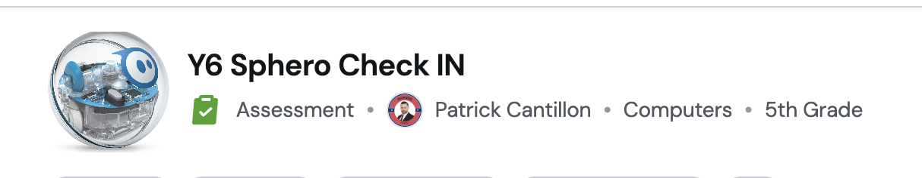
Quiz Time
https://wayground.com/admin/quiz/68c75d8cd53405ef368925b7
Notes:
https://wayground.com/admin/quiz/68c75d8cd53405ef368925b7
You will have to share this via QR code on your own account

